Slide 1
Applying to Higher Education
St Michael’s Catholic Grammar School

Slide 2
University Applications – making the choice
Course
Place of study
When to start
Mr P Ward

Slide 3
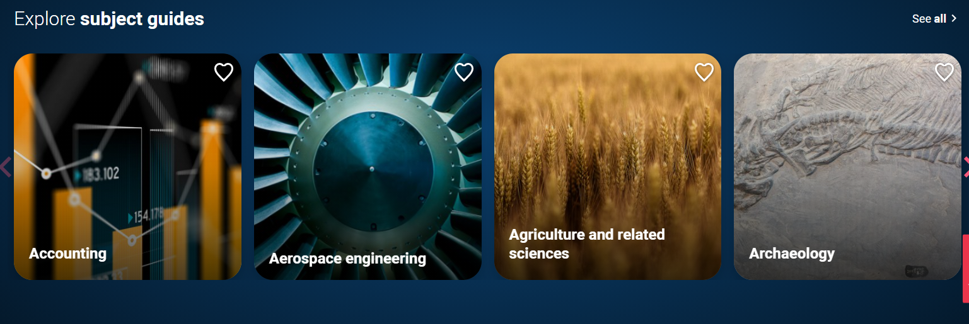
UCAS Subject Guide

Slide 4
Choosing the Course
Career aspirations
Favourite school subjects
A new subject
A combination of subjects

Slide 5
Place of study
Availability of course
Entry requirements
Environment
Distance from home

Slide 6
Oxford and Cambridge
Prestige
Tuition
College system
Employment opportunities

Slide 7
Our Expectations for Oxford and Cambridge
Predicted grades A*, A, A
A strong GCSE record
Prepared to read, widely within and beyond subject
Academic enrichment boosts your application.
Admissions tests and interview preparation essential

Slide 8
Support for Oxford & Cambridge Applications
Oxford and Cambridge Preparation for Interview Day
Interview Practice sessions and courses
Aptitude Tests Preparation Days. Medicine June
Christ College Admissions Test Workshops
OMS. UNIQ. Trinity Talks. Corpus Christi Masterclasses. HE+
Support applications to Summer Schools etc
Oxbridge Applications talk

Slide 9
Sources of Help
University websites
UCAS Hub. UCAS Subject Guide
UNIFROG
St. Michael’s staff
University prospectus
Personal Statements morning
Oxbridge (July)
Summer Schools

Slide 10
Applying to University
Mr Roberts

Slide 11
The Application
Submitted online through the UCAS website.
Personal data, qualifications, course choices, personal statement and reference.
Deadlines for Oxbridge, Medicine, Dentistry and Veterinary Science is 15th October, all others by half term before Christmas.
The process of making the application has already begun…

Slide 12
How we help at St Michael’s
March 2021
Tutorials introduce University Choices and research websites. Begin internet search of suggested courses and institutions using: www.ucas.co.uk and Individual institution websites.
Attend virtually UCAS Higher Education Conference
Year 12 Info “Into Higher Education”
Guest Speakers and Tutorials, including registration on UCAS Apply
Year 12 Personal Statements morning.
April 2021
June 2021
June 2021
July 2021

Slide 13
How we help at St Michael’s
September 2021
Finalise Course choices and Personal Statement. Print out your form and give it to your tutor who will have completed a draft reference. Only then do you submit your form and pay UCAS online by credit or debit card.
Deadline:
15th October 2021
for Oxbridge, Medicine, Veterinary Science
all other courses and institutions, October half term)

Slide 14
Briefly…the process:
Choose five universities
Submit form
Acknowledgement letter from UCAS
Interviews and/or conditional offers or rejections.
“firm” choice and “insurance” choice.
Results day

Slide 15
If things go wrong:
Extra – if rejected by all choices, can have an additional choice, this is repeated until successful.
Clearing – if a place has not been secured on results day.

Slide 16
How to apply successfully
Invest time in researching, discussing and visiting Universities and departments; and visiting their websites/reading prospectuses.
Finalise your personal statement and choices before coming back into upper sixth
Have a back-up plan.

Slide 17
GAP YEAR
Mr Ward

Slide 18
Is a gap year for me?
A useful break from education? An opportunity to do something completely different. A time to develop personal skills, become self reliant, achieve an understanding of strengths and weaknesses. A necessary decision in order to reapply with higher grades for your chosen course. A chance to save money before university. Unnecessary, there are long gaps during university anyway, 4 months, June to September. The right choice for only a minority of students?

Slide 19
Gap Year
More difficult because of COVID
Art Foundation
Au Pair in Europe
Camp Counselor in the USA
Work placement in UK
Language course
Travel restrictions
Project Trust –suspended
VSO ICS - suspended

Slide 20
Reasons for a Gap Year
Necessity-to obtain better grades for a course
Maturity-life experience so that a student makes more use of their undergraduate course
Financial-save a sum of money so that you enter university with greater financial security
Adventure-experience travel and world cultures
Uncertainty-undecided about future course and career choices

Slide 21
Reasons to avoid a gap year
Academic-could lose the study habit, universities think maths skills become rusty
Opportunity-realistically what amazing positions exist out there?
Cost-overseas projects are very expensive. You are more likely to spend money not save it during a gap year.
Unnecessary-long academic holidays provide the opportunity for work and travel

Slide 22
STUDENT FINANCE FOR HIGHER EDUCATION
Gerry Stonehouse
Careers Adviser LBB

Slide 23
STUDENT LOAN FOR FEES
All students can apply for the loan to cover tuition fees maximum of £9,250 a year
Loan paid directly to the university or college. Not repayable until after student finishes university and is earning £27,295
Fee amounts for English students studying in Wales, Scotland and Northern Ireland are the same.

Slide 24
STUDENT LOAN FOR MAINTENANCE
Now a system of student loans
Amount of loan will vary depending on the student’s circumstances e.g. living at home, living in London or away from home elsewhere. Household income affects the amount you can borrow.
Living at home- up to £7,987
Living away from home outside London-up to £9,488
Living away from home in London –up to £12,382
A year of a UK course studying abroad-up to £10,866

Slide 25
BURSARIES
There are other types of bursaries (non repayable) offered by universities. Most aimed at students from lower income families. A few available related to sporting achievement, academic excellence etc
NHS Bursary to cover fees for 5th and 6th year of Medicine or Dentistry
Amounts and criteria vary between HEIs
Check each university individually.

Slide 26
Interest on Loan
Depends on Rate of Inflation (RPI) and graduates’ earnings
While at university – RPI + 3%
Earning £27,295 or below – RPI
Income between £27,295 and £45,000 – Varies depending on income
Income £45,000+ - RPI + 3%

Slide 27
REPAYING THE STUDENT LOANS
Start repaying when finished course and earning over £27,295 a year.
Repayments 9% of income over £27,295 e.g. If earning £30,000 a year would repay £20 a month. If earning £50,000, pay back £170 a month
Repayments automatic through tax system.

Slide 28
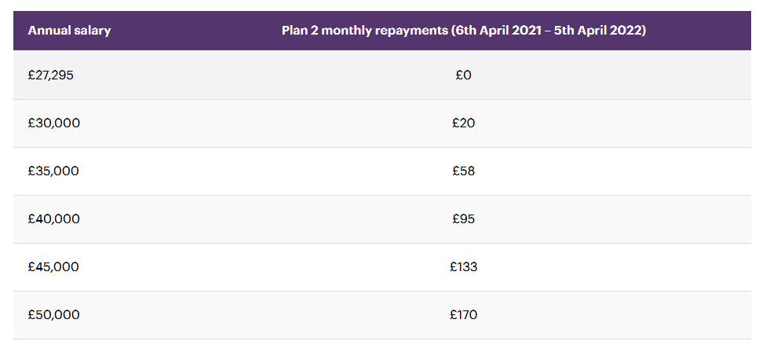
REPAYING THE STUDENT LOANS
.

Slide 29
ADDITIONAL FINANCIAL HELP
University Hardship Fund
Disabled Students Allowance
Care Leavers Grant
Sponsorship from employers.
Students can work as well as take out loans.

Slide 30
APPLYING FOR LOANS
Eligibility criteria – recognised course and residency requirements
Apply on line www.gov.uk/studentfinance
Apply as soon as have UCAS number do not wait for confirmation of a place. Need to provide ID.
Apply in good time !

Slide 31
CONTACTS FOR MORE INFORMATION
Student Finance England www.gov.uk/studentfinance
Telephone helpline 0300 100 0607
Student money site
www.scholarship-search.org.uk

Slide 32
APPRENTICESHIPS
Work based Learning
Higher Apprenticeship
Degree Apprenticeship
Available in a range of industries
www.apprenticeships.org.uk.
The UCAS website also displays apprenticeships.

Slide 33
Applying to Higher Education
St Michael’s Catholic Grammar School

