Slide 1
Politics (A Level)
The 15min session will cover the following
Politics at St Michael’s (information)
Why and how to study Politics
The 3 Politics units

Slide 2
Politics at St Michael’s
Results 2015
Y13: 78% A*/B, 100% A*-C
Results 2016
Y13: 88% A*/B , 100% A*-C
Results 2017
Y13: 69% A*/B, 100% A* -C
Results 2018
Y13: 93% A*/B, 100% A*-C
Results 2019
Y13: 80% A*/B , 100% A*-C
Results 2020
Y13 : 100% A*/B , 100% A* -C
Results 2021
Y13: 100% A*/A

Slide 3
Why to study politics
Current topics.
Relevant to today’s world.
Affecting our everyday lives.
Learn how to debate!
Bring together lots of subjects: History, Economics, Sociology, Law even... Psychology.
Highly desirable by university admission tutors.

Slide 4
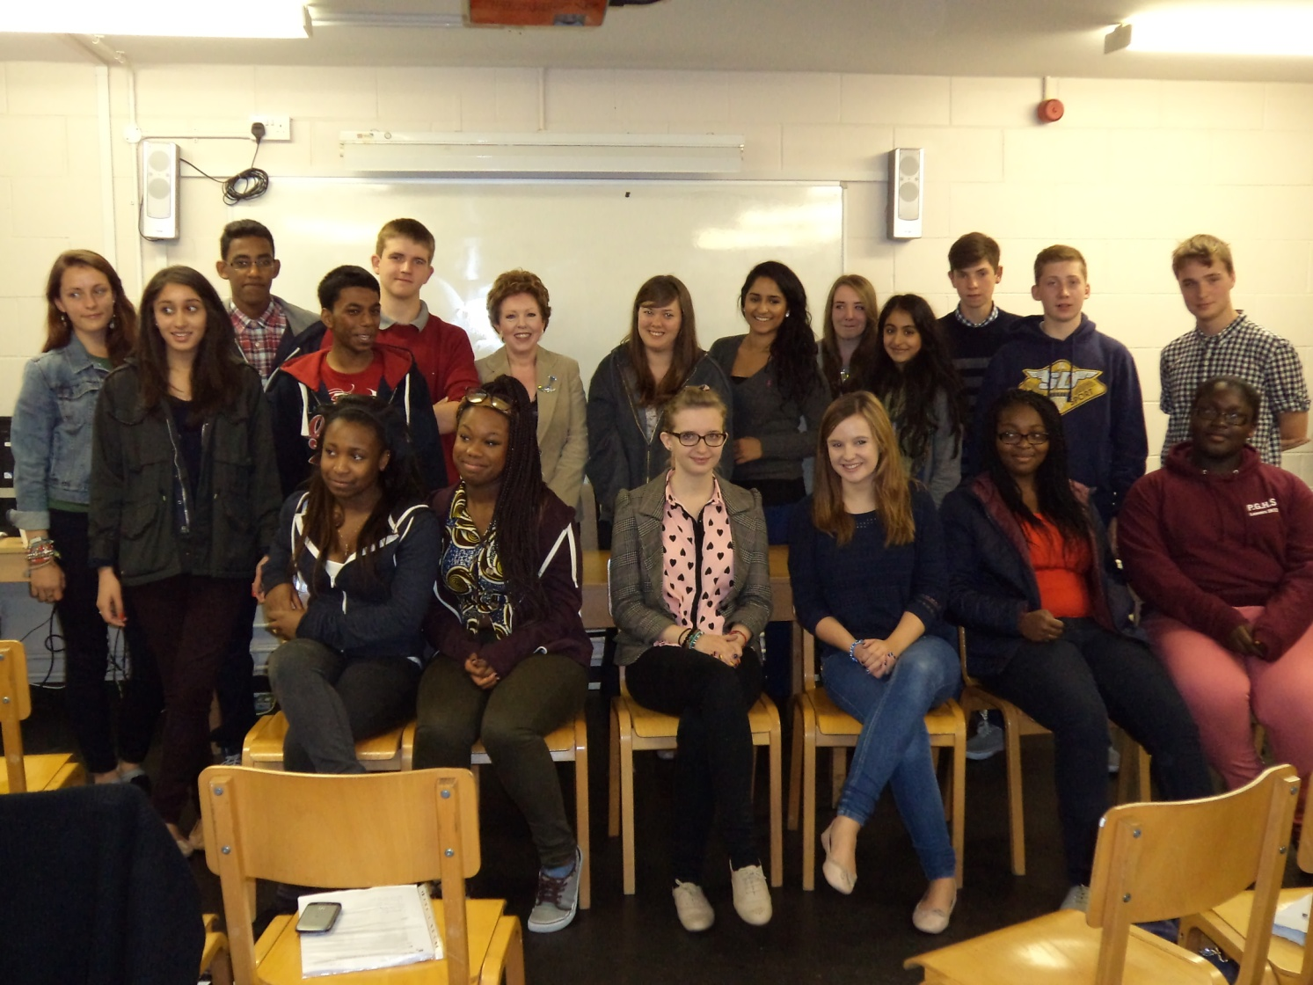
Visits and lectures

Slide 5
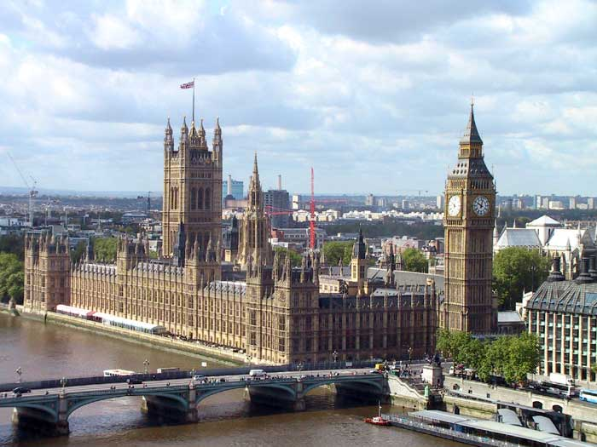
Theatre and PArliament visits

Slide 6
What are you going to study?

Slide 7
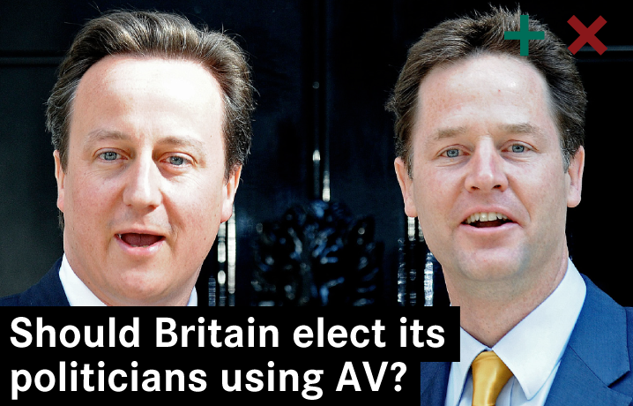

Slide 8
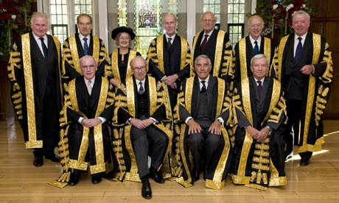

Slide 10
A Level
Unit 1: UK - Politics
Political Participation
Democratic participation
Electoral systems,voting behaviour and the media
Functions of political parties
Core Political Ideas –conservatism,liberalism,socialism
Unit 2: Governing the UK
The UK constitution
Role of the Prime Minister and the Cabinet
How the country is governed!
The role of the Parliament

Slide 11
A Level
Unit 3: Comparative Politics
USA – the US constitution and federalism, Congress, US presidency ,US supreme court, democracy and participation, civil rights

Slide 12
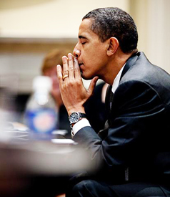
What skills are you going to acquire?
Analytical skills.
Evaluation.
Knowledge and understanding.
Essay writing.

Slide 13
Questions?
Is Trump going to win the 2024 election?
Is Trump going to appoint a fourth Supreme Court Justice?
What impact did covid-19 have on the US election and the world economy?
What impact will leaving the EU have on the UK ?

Slide 14
http://www.youtube.com/watch?v=zMdsOqGASRE&safe=active

